Slide 1



Building Rich Domain Models with DDD and TDD
Ivan Paulovich
Betsson Dev'talk #3
Stockholm – September 12th, 2018
https://paulovich.net
ivan@paulovich.net
@ivanpaulovich

Slide 2


Ivan Paulovich
Developer
Photo by Rafaela Biazi on Unsplash
30+ Microsoft Certifications
paulovich.net
Notes:
I am from Brazil.

Slide 3

Betsson Wallet Team
Seniors Developers
Agile Team
Business Oriented
.NET – SQL Server – Angular
Stockholm Office
We are hiring!

Slide 4
How to shoot yourself in the foot:
Design your application starting from the data model.
Create your domain model by reverse engineering.
Pretend that you’re doing TDD and start testing your domain classes.
Particularly getters and setters.
Now start testing the logic with Integration Tests and get stuck by test data and related issues.
Declare that TDD provides no benefit and only slows you down.
Comment tests in your Continuous Integration proccess.
Keep on whining.
Alberto Brandolini

Slide 5
DDD TDD
Tiny Domain Objects
Exploratoring Code
Focus on Unit Tests
Frequent Short Cycles
Frequent Rewriting
Quick Feedback
Self Explanatory Coding
Freedom to Change

Slide 6
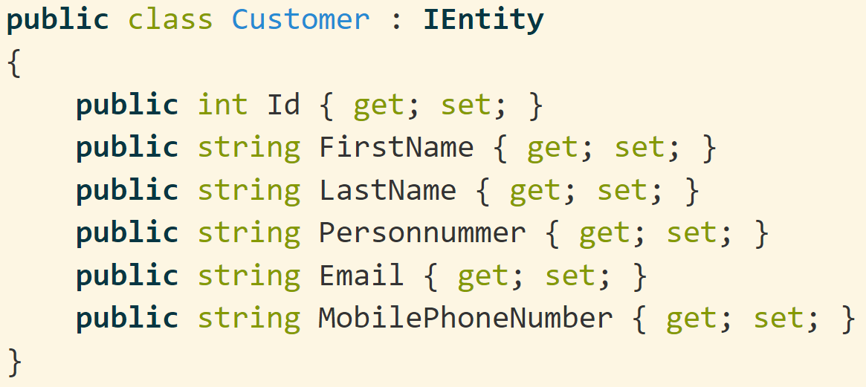
A Customer Entity with Primitive Obsession...

Slide 7
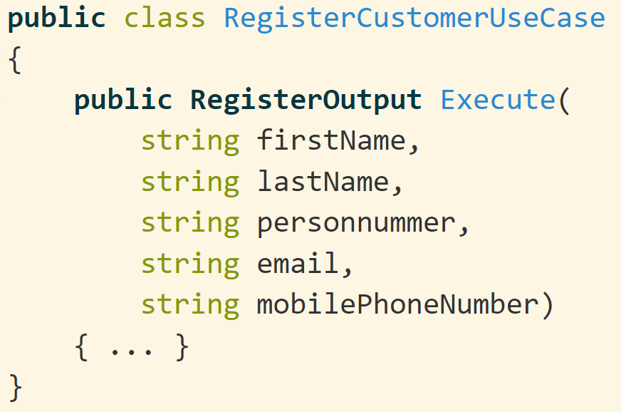
Leads to Services Like..

Slide 8
Leads to Services Like..
Needs to verify for required parameters
Needs to verify for Data Format
Needs to verify for Data Range
Services are Big and Fat
Easy to confuse one parameter with the another.
Notes:
If you're calling two setters in a row, you're missing a concept.

Slide 9
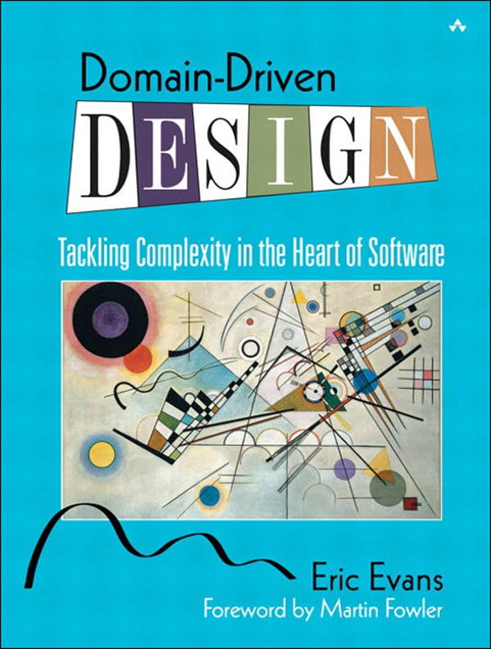
Not a technology.
Not a methodology.
Set of principles and patterns for focusing the design effort where it matters most.

Slide 10
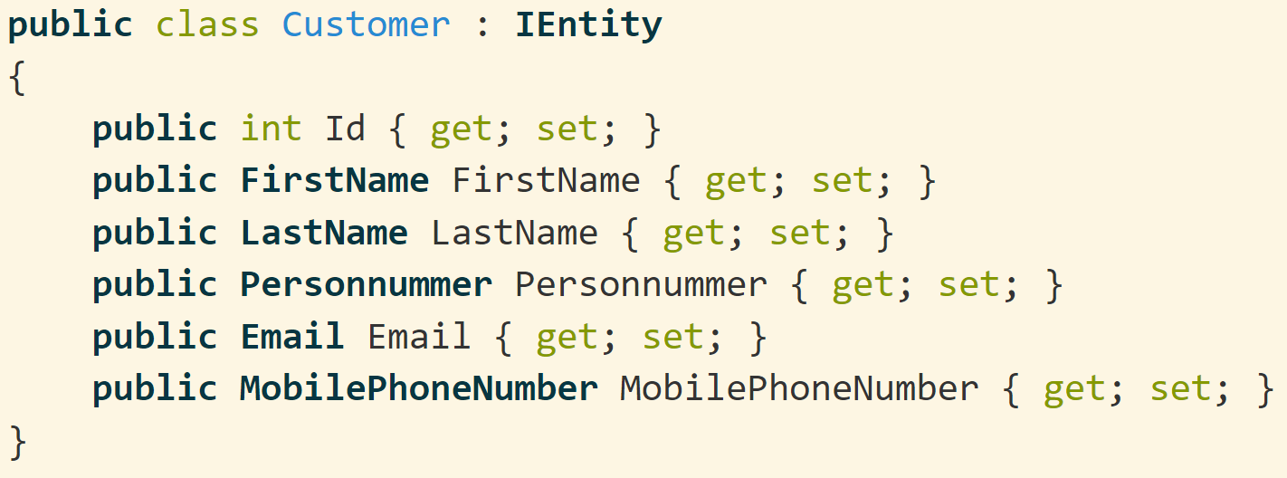
An Customer Entity Using Value Objects..

Slide 11
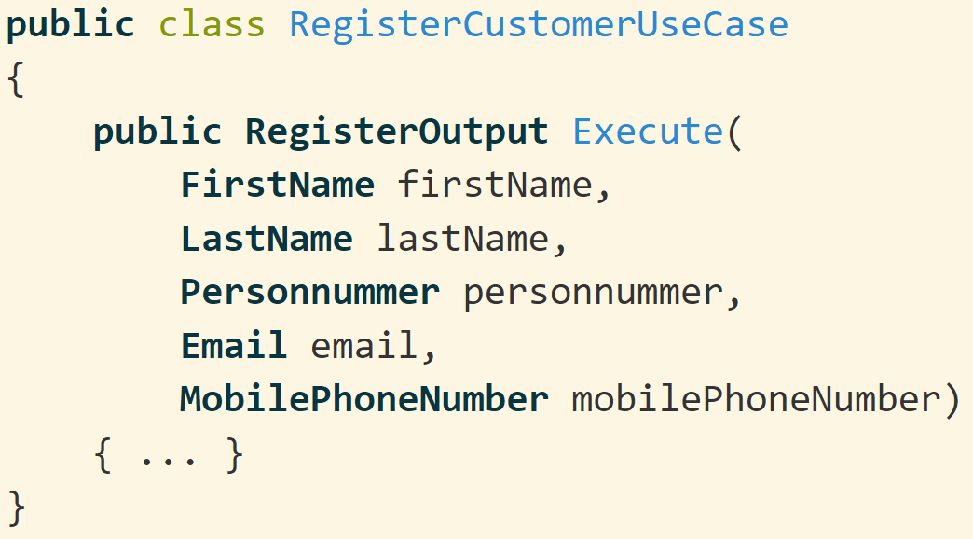
Business Rules Enforced Through Value Objects

Slide 12
Business Rules Enforced Through Value Objects
The simple existence of a Value Object means that it is valid.
No need to verify for the data format on every method.
Services are thinner when using Value Objets.

Slide 13
DDD express the Model with Value Objects, Entities and Services.

Slide 14
DDD express the Model with Value Objects, Entities and Services.
Some Entities act as root of Aggregates.

Slide 15
An Example with Some Use Cases
A customer can register a new account using its personal details.
Allow a customer to deposit funds into an existing account.
Allow to withdraw from an existing account.
Do not allow to withdraw more than the existing funds.

Slide 16
Customer 5557-8
Account Number 4444-6
Date | Description | Debit (SEK) | Credit (SEK) | Balance (SEK)
08-01-2018 | Initial Balance |  |  | 50,000
08-03-2018 | Withdrawal | 10,000 |  | 40,000
08-06-2018 | Withdrawal | 5,000 |  | 35,000
08-17-2018 | Deposited |  | 7,000 | 42,000
Account Number 7777-0
Date | Description | Debit (SEK) | Credit (SEK) | Balance (SEK)
08-01-2018 | Initial Balance |  |  | 10,000

Slide 17
An Example with Some Use Cases
A customer can register a new account using its personal details.
Allow a customer to deposit funds into an existing account.
Allow to withdraw from an existing account.
Do not allow to withdraw more than the existing funds.

Slide 18
Tactical-Design
First Name
Customer
Last Name
Account
Opening Date
Personnummer
Mobile Phone Number
Amount
Debit
Amount
Credit
Transaction Date
Transaction Date
Amount
Description
Description

Slide 19
Tactical-Design
First Name
Customer
Last Name
Account
Opening Date
Personnummer
Mobile Phone Number
Amount
Debit
Amount
Credit
Transaction Date
Transaction Date
Amount
Description
Description

Slide 20
Tactical-Design
First Name
Customer
Personal Expenses Bounded Context
Last Name
Account
Opening Date
Personnummer
Mobile Phone Number
Amount
Debit
Amount
Credit
Transaction Date
Transaction Date
Amount
Description
Description

Slide 21
Technical Aspects of Design
Technical Terms
Technical Design Patterns
Business Terms Developers Don’t Understand
Business Terms Everyone Uses That Don’t Apper in Design
Domain Model Terms
Names of Bounded Contexts
Terminology of Large-scale Structures
DDD Patterns Names
Developers
Domain Experts
Ubiquitous Language

Slide 22
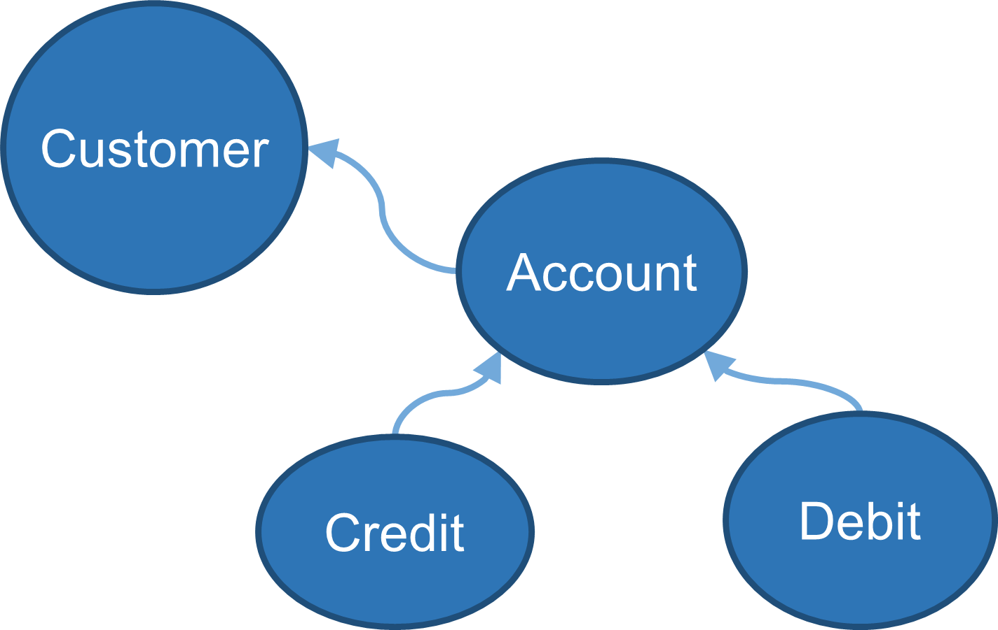
Entities
Have a unique identity.
Are mutable or not.
Refer others entities by their IDs.
Don't get trapped by datastore thinking.

Slide 23
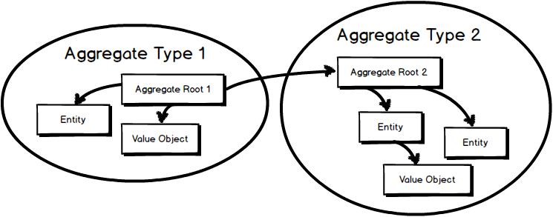
Aggregate Roots (Are Entities)
Refer other aggregates by identity only.
Scope of consistency inside the aggregate boundaries and update other aggregates through eventual consistency.
Aggregates are small.
Aggregates implement behaviors.
One Aggregate Root for every Entity is a Code Smell.

Slide 24

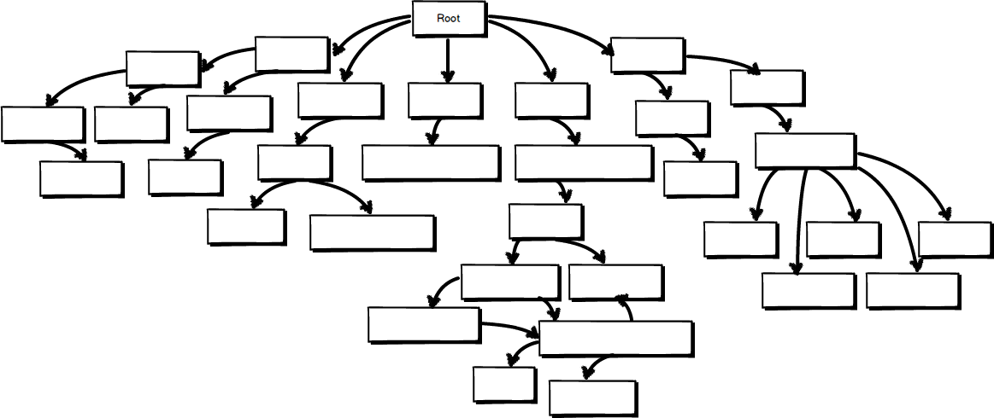
An Aggregate Root is not your Entire Model

Slide 25

An Aggregate Root

Slide 26
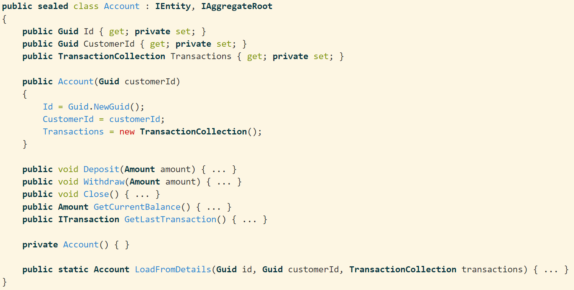
Account Aggregate Root

Slide 27
Account Aggregate Root
It is an Entity

Slide 28
Account Aggregate Root
It is an Entity
Only mandatory fields are required in the constructor

Slide 29
Account Aggregate Root
It is an Entity
Only mandatory fields are required in the constructor
Implements behaviors which maintain the state consistent.

Slide 30
Account Aggregate Root
It is an Entity
Only mandatory fields are required in the constructor
Implements behaviors which maintain the state consistent.
Factory method to restore state.

Slide 31
Value Objects
Immutable.
Have no explicit identity.
Unique by the comparisson of the atributes.
Used to describe, measure or quantify an Entity.
First Name
Last Name
Personnummer
Amount
Description
Mobile Phone Number

Slide 32
.NET Bounded Context
Personal Expenses Bounded Context
Mobile Phone Number
string

Slide 33
.NET Bounded Context
Personal Expenses Bounded Context
Clone
Compare
CompareOrdinal
CompareTo
Concat
Contains
Copy
CopyTo
Create
EndsWith
Equals
Format
GetEnumerator
GetHashCode
GetTypeCode
IndexOf
IndexOfAny
Insert
Intern
IsInterned
IsNormalized
IsNullOrEmpty
IsNullOrWhiteSpace
Join
LastIndexOf
LastIndexOfAny
Normalize
PadLeft
PadRight
Remove
Replace
Split
StartsWith
Substring
ToCharArray
ToLower
ToLowerInvariant
ToString
ToUpper
ToUpperInvariant
Trim
TrimEnd
TrimStart
Mobile Phone Number
string

Slide 34
.NET Bounded Context
Personal Expenses Bounded Context
Clone
Compare
CompareOrdinal
CompareTo
Concat
Contains
Copy
CopyTo
Create
EndsWith
Equals
Format
GetEnumerator
GetHashCode
GetTypeCode
IndexOf
IndexOfAny
Insert
Intern
IsInterned
IsNormalized
IsNullOrEmpty
IsNullOrWhiteSpace
Join
LastIndexOf
LastIndexOfAny
Normalize
PadLeft
PadRight
Remove
Replace
Split
StartsWith
Substring
ToCharArray
ToLower
ToLowerInvariant
ToString
ToUpper
ToUpperInvariant
Trim
TrimEnd
TrimStart
Mobile Phone Number
string
Create
GetAreaCode
GetLastFourDigits
ToString

Slide 35
We only pay for the complexity we really use
Without Value Objects
With Value Objects
We bring the .NET Framework Complexity into our Bounded Context.
Personal Expenses Bounded Context
Personal Expenses Bounded Context
Phone Number
null
Thread
string int
collection
.NET Bounded Context
double
string
int
null
Thread
collection
HttpClient
.NET Bounded Context
Reflection
double
HttpClient
Reflection

Slide 36
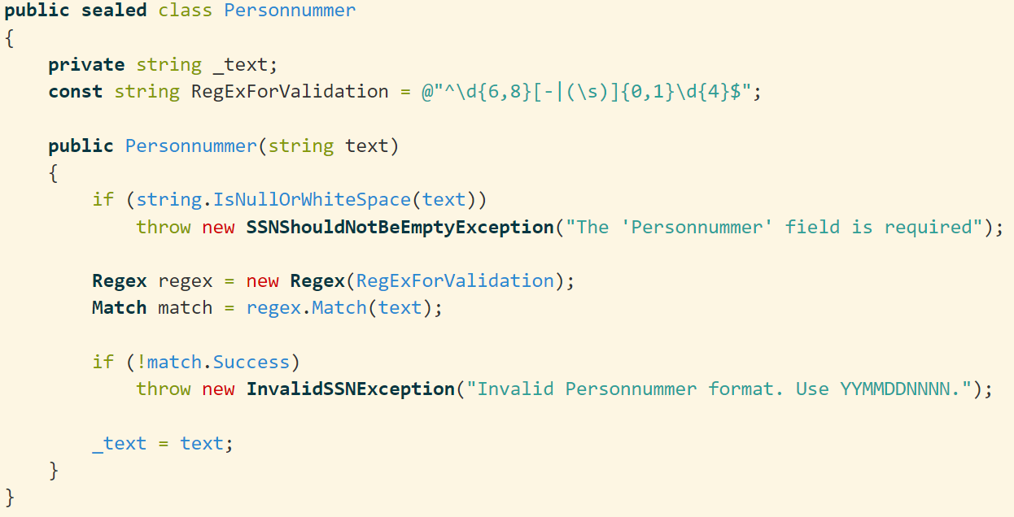
Personnummer Value Object
Notes:
it simple do not exist if invalid

Slide 37
First-Class Collections
Each collection should be wrapped in its own class¹.
Classes that contains collections do not contains any other variable.
Behaviors have a home.
When necessary return immutable collection copies.
Account
Transaction
1:N
¹The ThoughtWorks Anthology: Essays on Software Technology and Innovation (Pragmatic Programmers), 2008

Slide 38
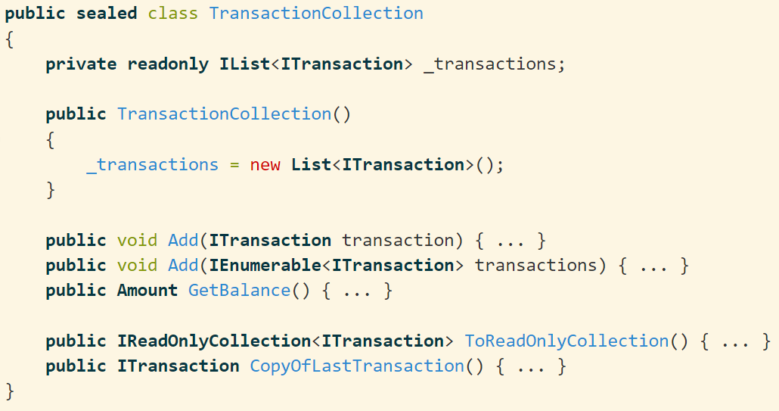
First-Class TransactionCollection
Notes:
it simple do not exist if invalid

Slide 39
First-Class TransactionCollection
Copy collections and mutable objects when passing them between objects.¹
¹Growing Object-Oriented Software Guided by Tests, 2010
Notes:
it simple do not exist if invalid

Slide 40
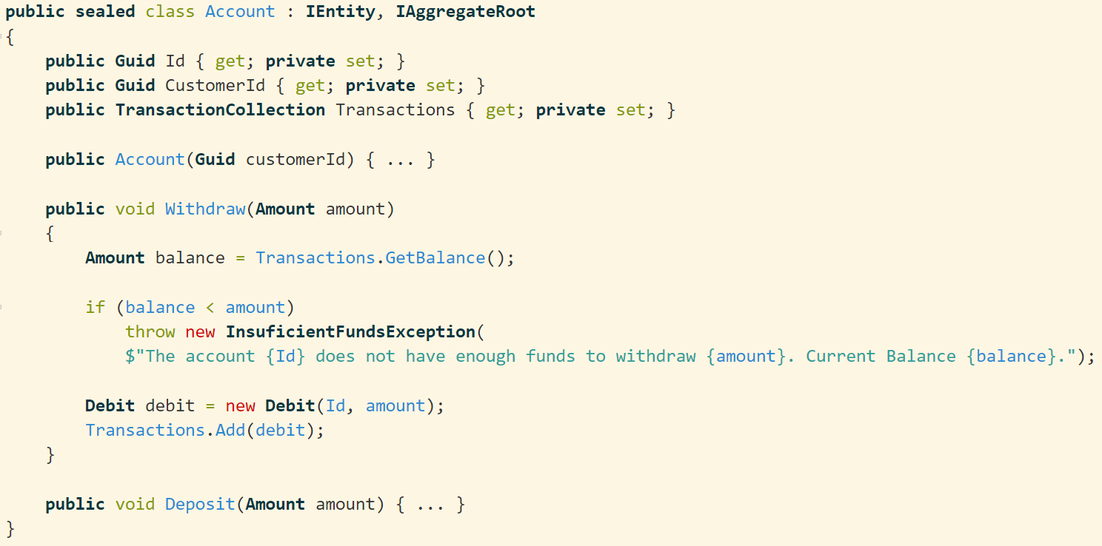
How to Use the TransactionCollection Class
Notes:
it simple do not exist if invalid

Slide 41
How to Use the TransactionCollection Class
The GetBalance() implementation belongs to the TransactionCollection class.
Notes:
it simple do not exist if invalid

Slide 42
How to Use the TransactionCollection Class
Composite simpler than the sum of its parts
The GetBalance() implementation belongs to the TransactionCollection class.
Notes:
it simple do not exist if invalid

Slide 43
Inner and outer feedback loops in TDD
Write a failing acceptance test
Write a failing unit test
Make the
test pass
Refactor

Slide 44
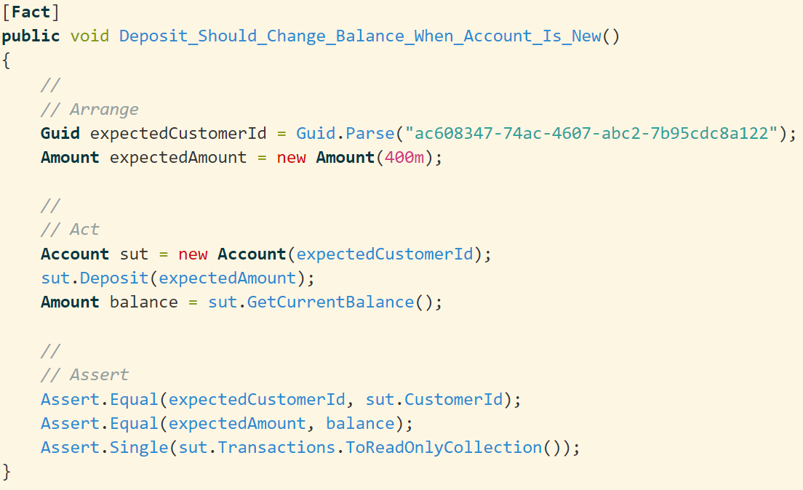
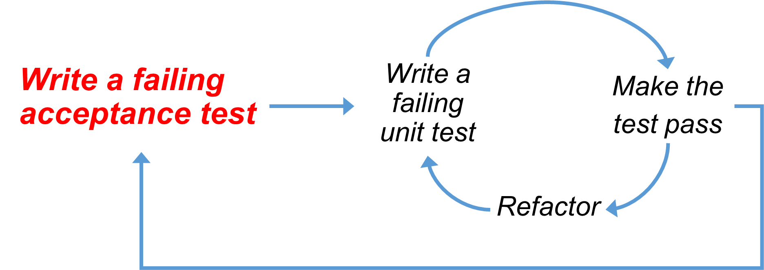
Notes:
it simple do not exist if invalid

Slide 45
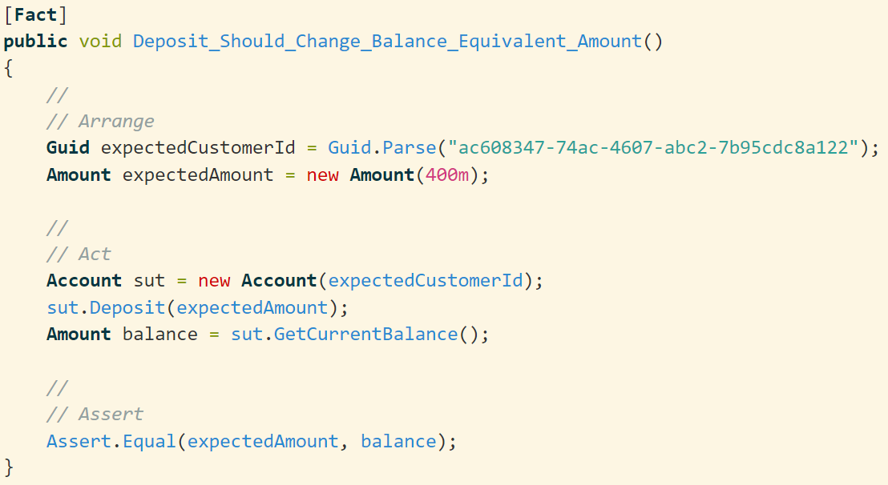
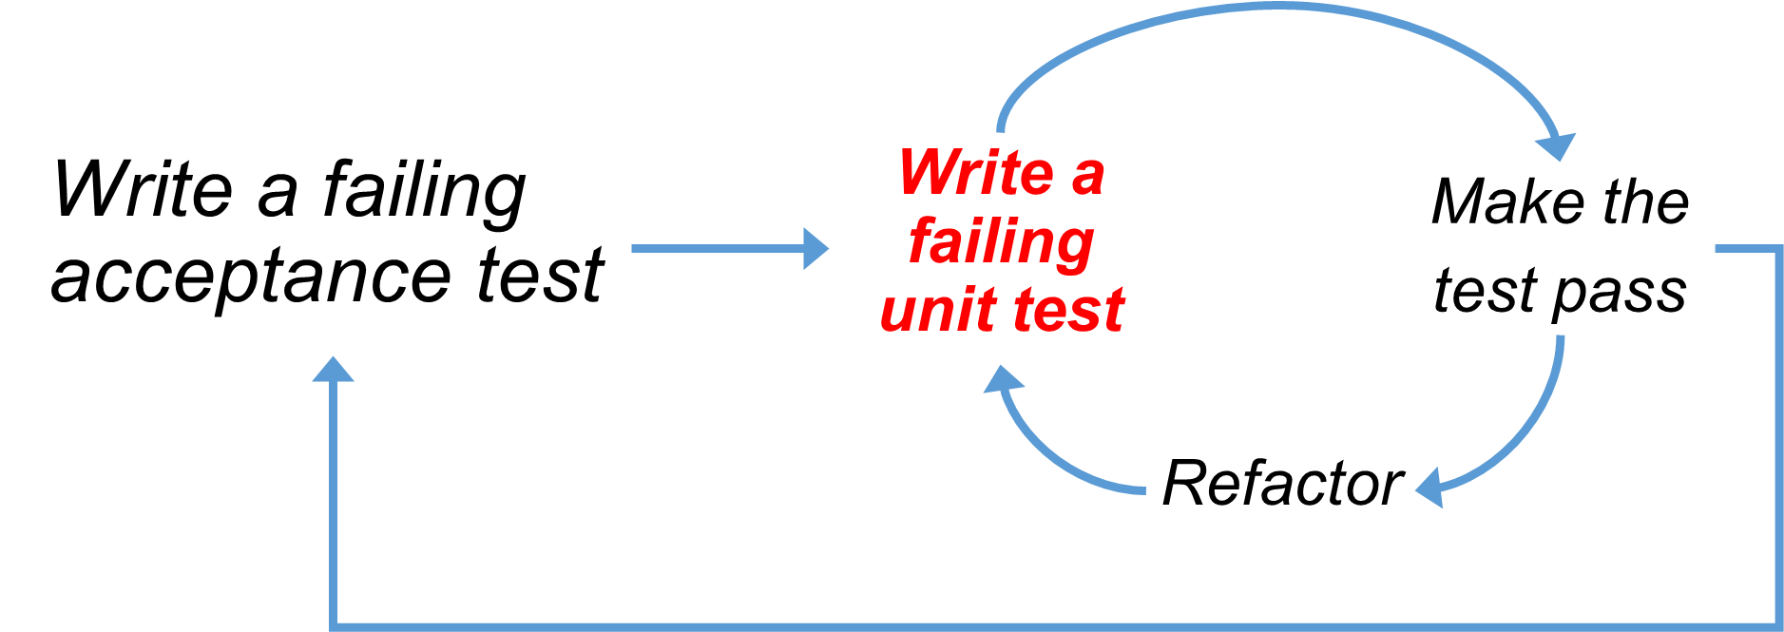
Notes:
it simple do not exist if invalid

Slide 46
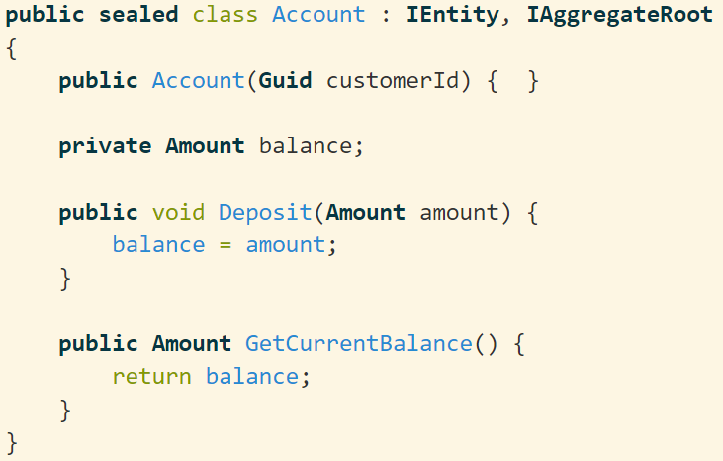
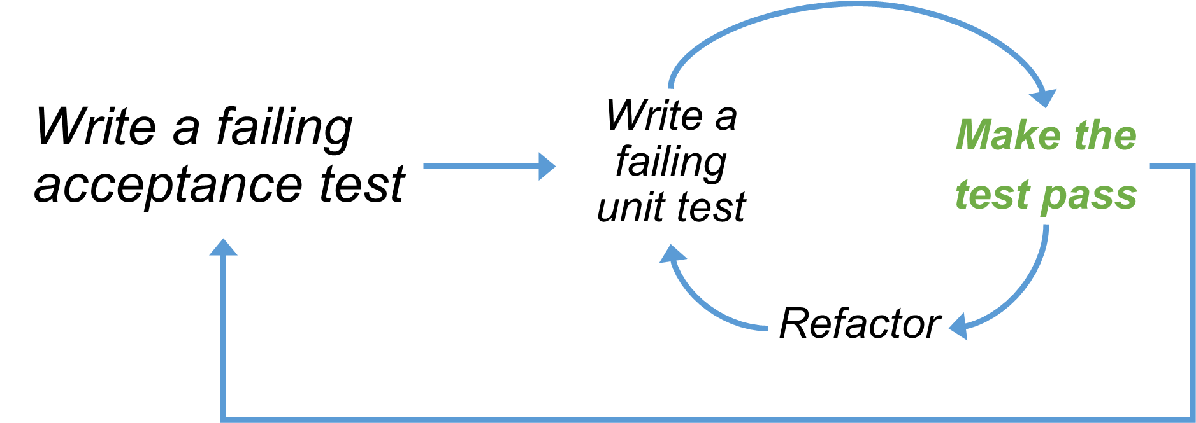
Notes:
it simple do not exist if invalid

Slide 47
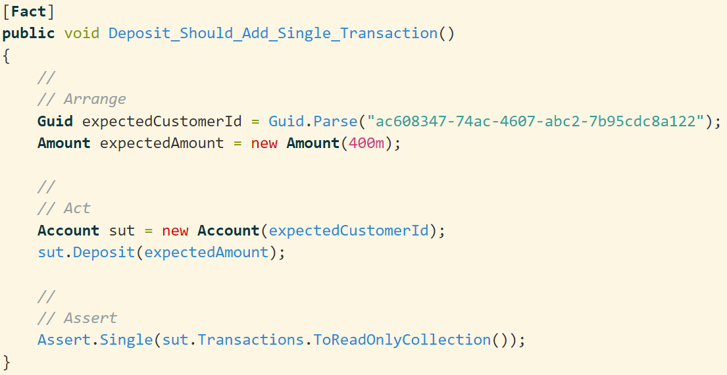
Notes:
it simple do not exist if invalid

Slide 48
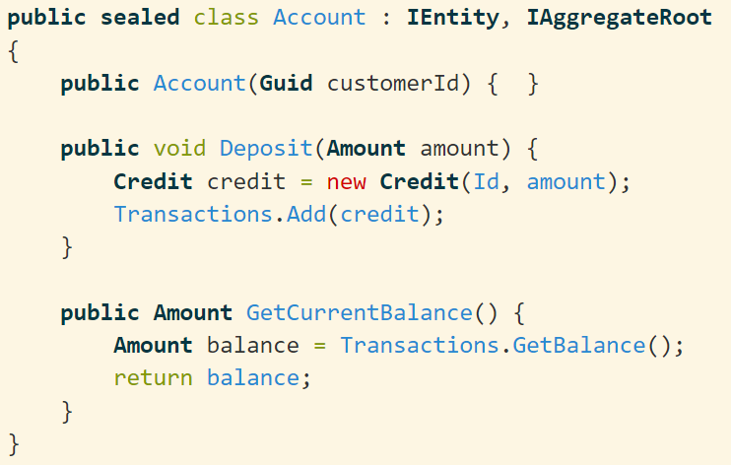
Notes:
it simple do not exist if invalid

Slide 49
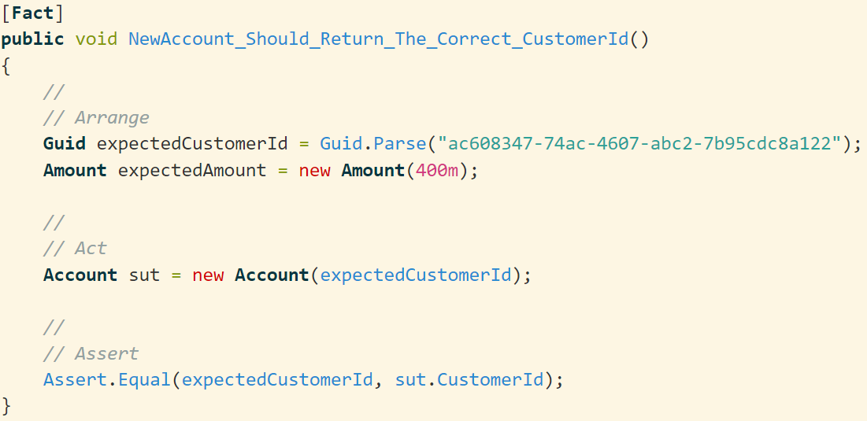
Notes:
it simple do not exist if invalid

Slide 50
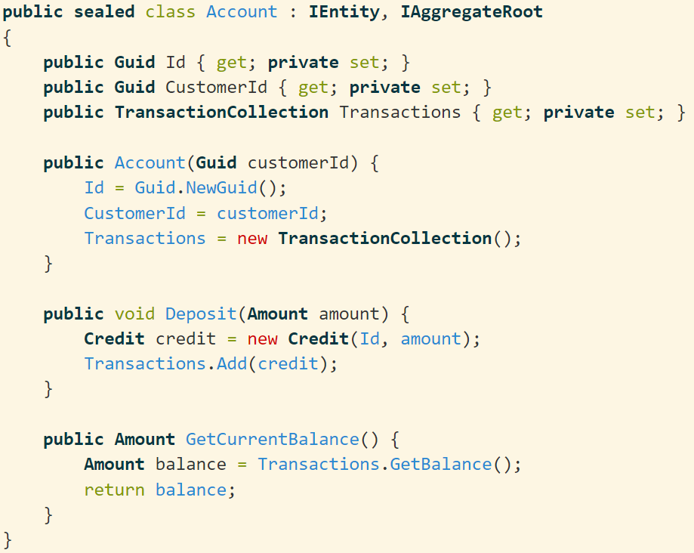
Notes:
it simple do not exist if invalid

Slide 51
Opinionated DDD/TDD
Sometimes I implement too much of the Domain Model. Then return to covering it with unit tests.
By knowing the DDD patterns I understimate the TDD value then I'm slapped in the face.
My goal is to maintain a high test coverage on the Domain Model.
If testing is hard. It is an architectural issue!

Slide 52
I won’t reverse engineer my data model to create a domain model.

Slide 53
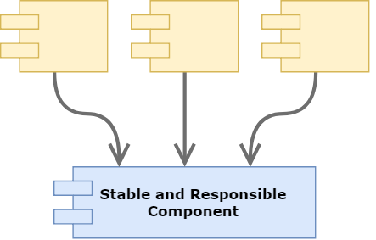
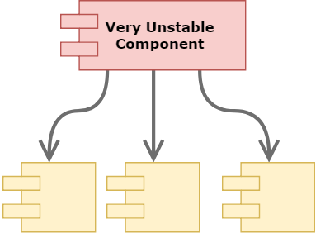
The Stable Dependencies Principle¹
¹Clean Architecture, Robert C. Martin, 2017

Slide 54
The Stable Dependencies Principle
Infrastructure
Web
Application
Domain

Slide 55

The Stable Dependencies Principle
Infrastructure
Web
Application
Domain
Shinning Framework
Shinning Library

Slide 56
The Stable Dependencies Principle
Infrastructure
Web
Application
Domain
Shinning Framework
Shinning Library

Slide 57
Isolate the Domain with a Layered Architecture
Web
Devices
Controllers
Use Cases
Outside In
Entities
Inside Out
Gateways
DB
UI
Presenters
External Interfaces

Slide 58
Isolate the Domain with a Layered Architecture
Testability
Hexagonability
Use Cases as First-Class
Decoupled
Web
Devices
Controllers
Use Cases
Entities
Presenters
Gateways
DB
UI
External Interfaces

Slide 59
Quick Review
DDD Patterns
Ubiquitous Language
Testing
Application Design
Implementation Samples

Slide 60
Quick Review
DDD Patterns
Ubiquitous Language
Testing
Application Design
Implementation Samples

Slide 61
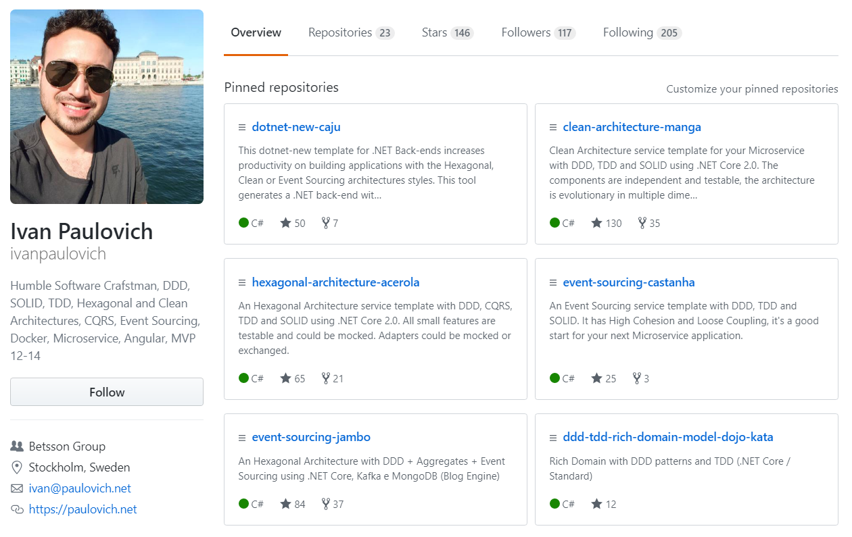
Implementation Samples
Fork me on GitHub
Clean Architecture
Hexagonal Architecture
Event Sourcing
DDD
TDD
Microservices

Slide 62
Resources
Domain-driven Design, Eric J. Evans, 2003
The ThoughtWorks Anthology: Essays on Software Technology and Innovation (Pragmatic Programmers), 2008
Clean Architecture, Robert C. Martin, 2017
Growing Object-Oriented Software, Guided by Tests, 1st Edition, 2009

Slide 63
https://paulovich.net
ivan@paulovich.net
@ivanpaulovich

Slide 64
@ivanpaulovich

Slide 65
Inner and outer feedback loops in TDD
Write a failing acceptance test
Write a failing unit test
Make the
test pass
Refactor

Slide 66
Inner and outer feedback loops in TDD
Write a failing acceptance test
Write a failing unit test
Make the
test pass
Refactor

Slide 67
Inner and outer feedback loops in TDD
Write a failing acceptance test
Write a failing unit test
Make the
test pass
Refactor

Slide 68
Inner and outer feedback loops in TDD
Write a failing acceptance test
Write a failing unit test
Make the
test pass
Refactor

